Slide 1
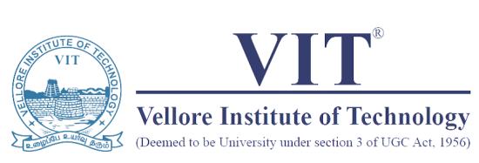
Module 4
Sensor Fabrication
Text Book(s)
1. Winncy Y. Du, “Resistive, Capacitive, Inductive, and Magnetic Sensor Technologies”, 2019, 1st Edition, CRC press, London.
2. B. C. Nakra and K. K. Chaudhary, “Instrumentation, Measurement and Analysis”, 2016, 4th Edition, McGraw Hill Education India Private Limited.
Reference Books
1. A.K. Sawhney, “A Course in Electronic Measurements and Instrumentation”, 2015, Dhanpat Rai & Co. (P) Limited.
2. Ramón Pallás-Areny and John G. Webster, “Sensors and Signal Conditioning” 2012, 2nd Edition, John Wiley and Sons, Inc.
3. Pethuru Raj and Anupama C. Raman, "The Internet of Things: Enabling Technologies, Platforms, and Use Cases", CRC Press, 2017.
4. Nihtianov, Stoyan, and Antonio Luque, eds. Smart sensors and MEMS: Intelligent sensing devices and microsystems for industrial applications. Woodhead Publishing, 2018.

Slide 2
Sensor Technology
Over the years, a number of materials and technologies have been developed in the fabrication of sensors.
Materials used:
Inorganic → Single crystals: quartz, Si, and compound semiconductors;
Polycrystalline and amorphous: ceramics, glasses, composites; and metals.
Organic → mainly Polymers – (used in Flexible electronics)
however, recently, lipids, enzymes, and biochemical compounds (e.g., antibodies,
DNA molecules) are been used in biosensors.
Fabrication Technology used:
Thin film technology → Stencil Mask, Photolithography, etc
Thick film technology → Screen Printing, Ink-jet printing, Roll-to-roll process, etc
Patterning/Designing Sensors

Slide 3
Patterning/Designing Sensors
Designing of Microheaters:
W
R=ρL/Wt
L
Patterned Microheater (NiCr)
Variation in width, W:
If W is increased from 10 µm to 100 µm, then the associated
Temperature also increases with increasing line width for a fixed voltage V.
Temp α Power α V²/R → R α 1/W
Variation in length, L:
If L is increased from 100 µm to 1000 µm, then the associated
Temperature falls with increasing heater length for a fixed voltage V.
Temp α Power α V²/R → R α L

Slide 4
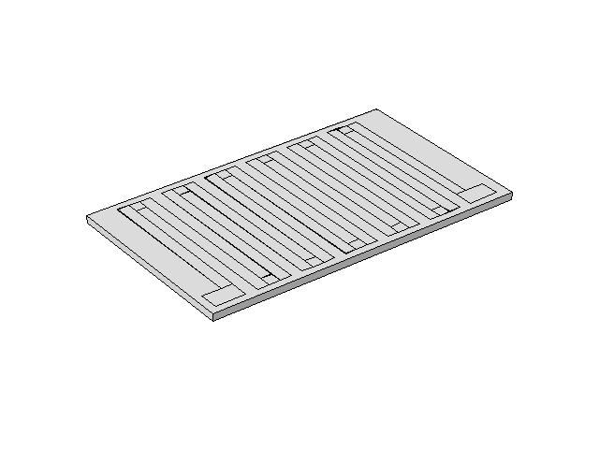
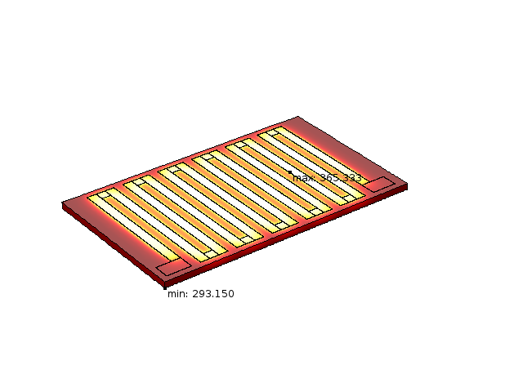
Heat Distribution:
Increasing W, increases the associated temperature.
Increasing L, decreases the associated temperature.
Uniform heat distribution → Balance between W and L
(within a particular chip area)
Increasing the length over the same chip area
Meanderline design
CAD Design
Simulated Heat Distribution

Slide 5
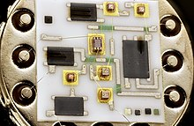
Thick Film Technology
A thick film is a layer of material ranging from few tens of micrometers to several hundreds of micrometers in thickness ( ~10 µm to ~500 µm).
Thick-film technology was introduced about thirty years ago as a means of producing hybrid integrated circuits (HIC) →is a miniaturized electronic circuit constructed of individual devices, such as semiconductor devices (e.g. transistors, diodes or monolithic ICs) and passive components (e.g. resistors, inductors, transformers, and capacitors), bonded to a substrate or printed circuit board (PCB).
HIC is fabricated by inter-connecting a number of components on a substrate whereas an IC's (monolithic) components and interconnects are fabricated on a single wafer
https://en.wikipedia.org/wiki/Hybrid_integrated_circuit
Thick film technology is often used as the interconnecting medium for hybrid integrated circuits. The use of screen printed thick film interconnect provides advantages →feature sizes may be larger, wider in tolerance, explore diff materials, diff properties, etc.

Slide 6
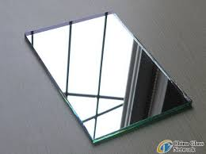
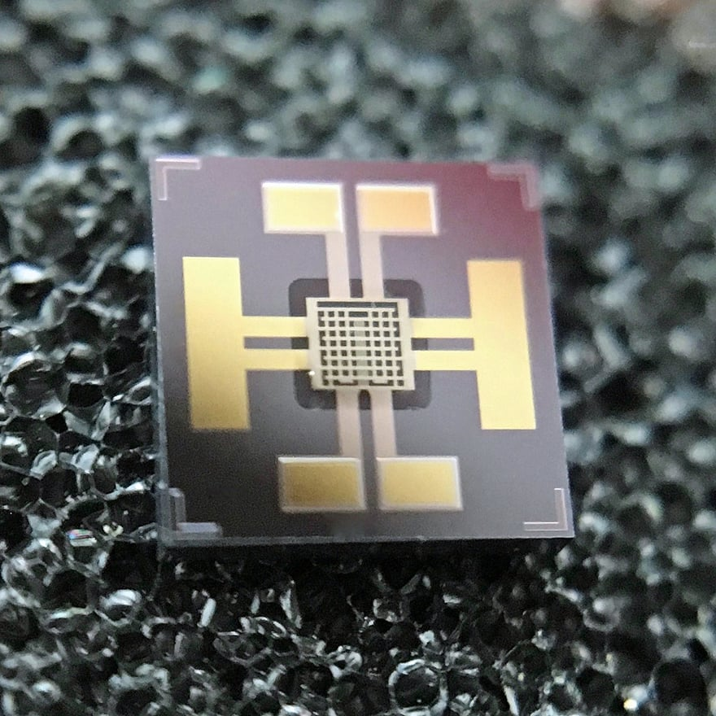
Thin film Technology
A thin film is a layer of material ranging from fractions of a nanometer (monolayer) to several micrometers in thickness ( few nm to ~10 µm).
A familiar example is the household mirror, which typically has a thin metal coating on the back of a sheet of glass to form a reflective interface.
Applications:
magnetic recording media,
electronic semiconductor devices,
LEDs,
optical coatings (such as antireflective coatings),
Hard coatings on cutting tools,
Energy generation (e.g. thin-film solar cells)
Storage (thin-film batteries).
Pharmaceuticals, via thin-film drug delivery.
Thin film based gas sensor

Slide 7
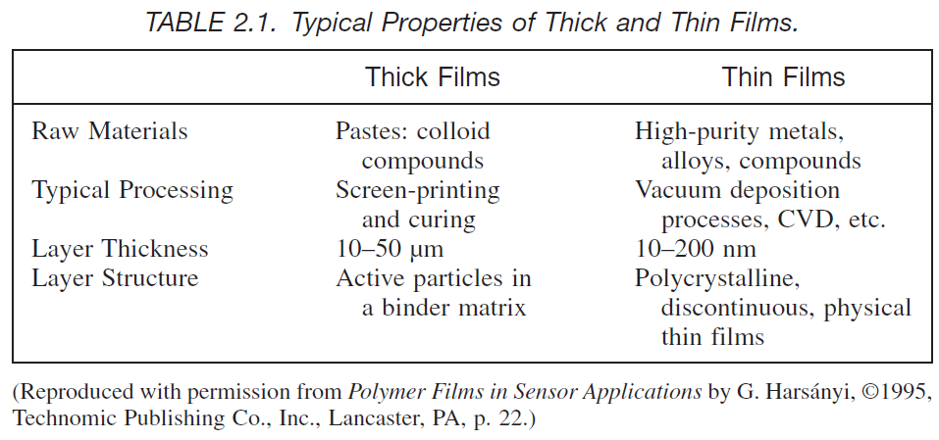

Slide 8
Thick Film Technology – Screen Printing
Thick-film circuit is the method of film deposition, namely screen printing, which is
possibly one of the oldest forms of graphic art reproduction.
Thick-film sensors are a relatively new application of the technology and thick-film hybrid circuits are generally regarded as being compact, robust and relatively inexpensive and have found application in areas such as televisions, calculators, telephones, automotive electronics and missile guidance systems to name but a few.
Raw materials for thick films are available in “paste” form. It has three main ingredients:
a finely powdered functional phase (metal and/or metal-oxide powders) of carefully controlled size and composition;
finely powdered oxide and glass phases, also of controlled size, shape, and composition (as inorganic binder materials);
an organic vehicle that suspends the inorganic constituents until the paste is fired and must also give the proper rheological characteristics for the screen printing.

Slide 9
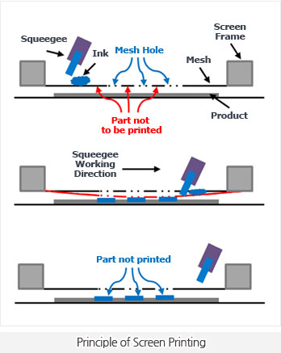
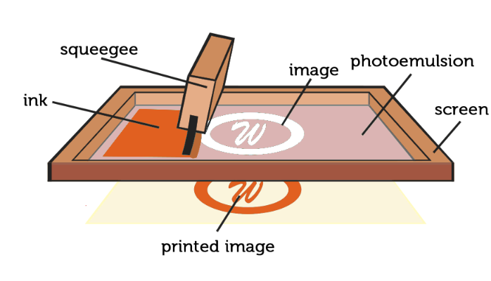
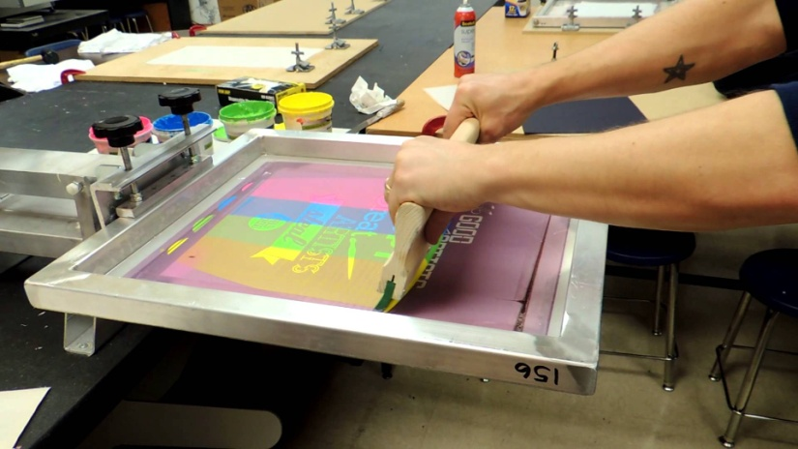
The basic tools used in printing are the squeegee and the screen.

Slide 10
Process Details:
The holes of the stainless steel, polyester, or nylon screen are filled with a photolithographically shaped emulsion, which has openings according to the layout pattern.
The substrate is placed under the screen, and the squeegee presses the paste through the screen mask openings.
After the film has been printed on a substrate, it should be allowed to “settle,” since printing through the screen tends to produce mesh lines in the pattern. The settling time depends on the viscosity of the paste; however, times vary from about 5 minutes to approximately 20 minutes.
After settling, the films should be dried before firing. This removes only the volatile and leaves behind the binders. Desirable drying temperatures depend on the solvents and vary from 100 to 150°C for 5 to 15 minutes. The resulting films should be tough enough to permit handling and subsequent printings.
Firing is the most critical step of thick-film technology. The temperature profile and atmosphere parameters are the most important. Thick-film pastes require peak temperatures in the range of 700–1000°C (typical value is 850°C) for 10 minutes. Temperature should be controlled to better than 3 °C at the peak. For firing, belt furnaces are used.

Slide 11
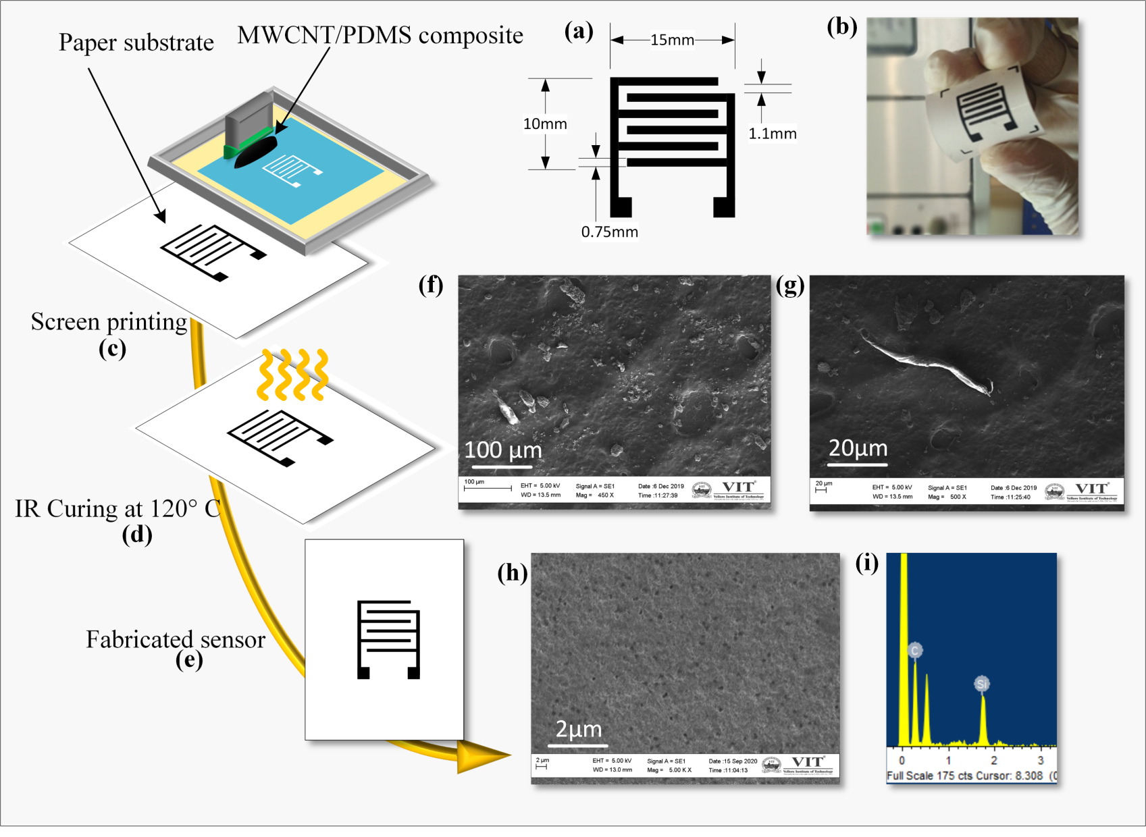
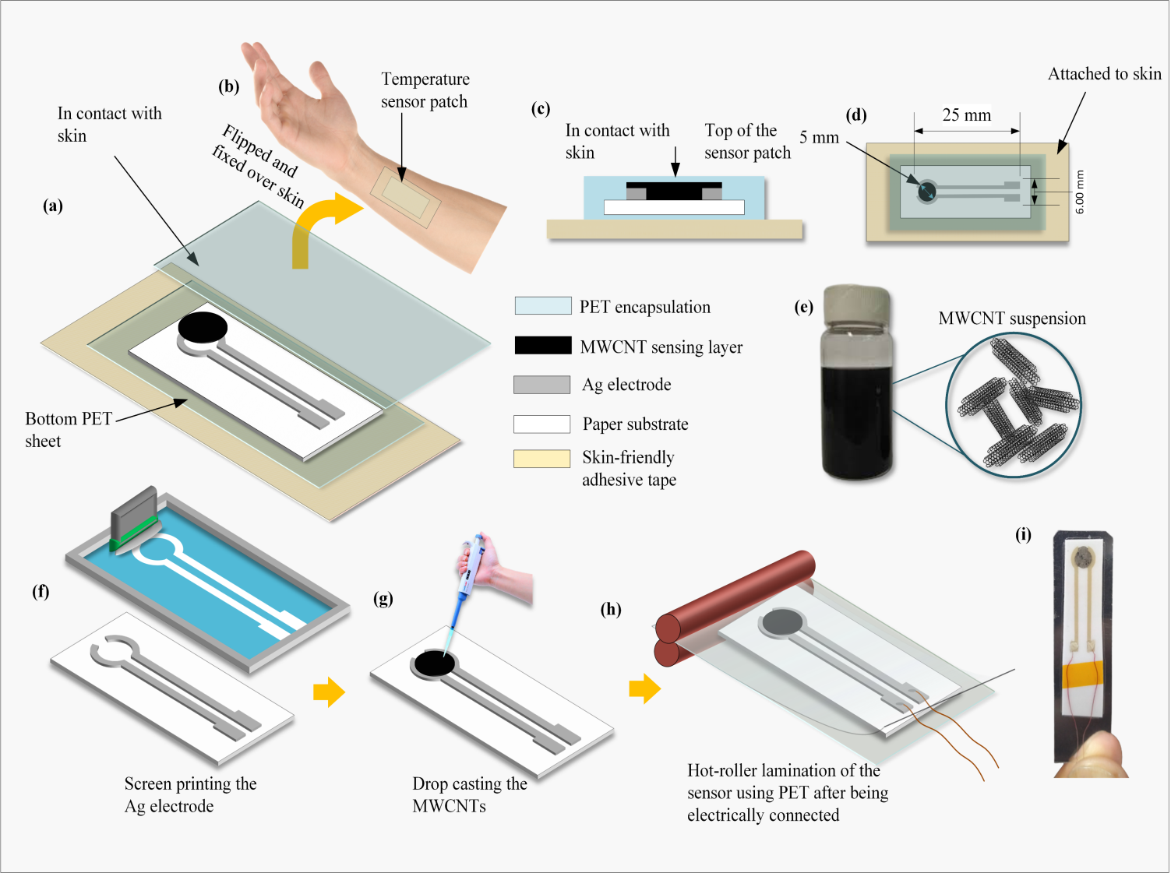


Patterned Sensors
Breath Sensor
Temperature
Sensor

Slide 12
Thin-film Technique - Photolithography
Thin films are an integral part of IC and microsystems fabrication. In ICs thin films are largely used as conductors or insulators.
These may be broadly classified into:
1. Metals - Metal films are used to form low-resistance ohmic connections to heavily doped n+ / p+ regions or poly-Si layers,
- Also used as contacts in metal-semiconductor barriers.
2. Dielectrics (including ceramics and polymers)
- dielectric films like SiO₂ and Si₃N₄ are used as insulating layers.
- ceramic thin film materials such as PZT and barium strontium titanate (BST) are used in many smart systems applications.
- plastic materials like polyethylene (PE), polyvinyl chloride (PVC), polymethyl methacrylate (PMMA),and polydimethylsiloxane (PDMS)
3. Functional materials - those materials that perform specific functions other than possessing a load bearing capacity. Examples include semiconductors, magnetic materials, piezoelectrics and ionic conductors..

Slide 13
The source material for depositing these thin films on a substrate can be in the gaseous, liquid, plasma, or solid state.
The deposited films are characterized by their grain size, thickness, uniformity, step coverage, adhesion, and corrosion resistance.
Thin film characteristics such as continuity, uniformity, surface properties, and adhesion need to be evaluated to determine the suitability of thin films for a particular application.
Metal thin Film Deposition
Metal films are useful in forming low resistance ohmic contacts and conductivity paths for interconnects.
The most commonly used materials for these requirements are Al and Au.
Metal films can be formed by physical vapour deposition (PVD) and chemical vapour deposition (CVD) processes - In these processes, favorable conditions are created to transfer the material from the source (target) to the destination (substrate).
In the PVD process, this transfer takes place by physical means such as evaporation or impact, while in the CVD process, this happens through a chemical reaction.

Slide 14
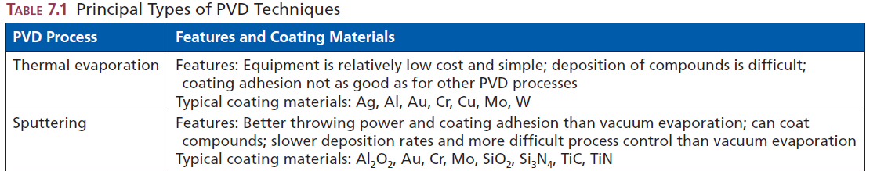
Physical Vapour Deposition (PVD):
The PVD techniques may be grouped into five principal types:
Thermal evaporation,
Sputtering,
Ion plating and cluster deposition,
Laser sputter deposition or laser ablation deposition, and
Aerosol deposition
Most PVD processes consist of the following elementary steps:
The synthesis of the coating vapour from the source material,
Transport of the vapour to the substrate, and
Condensation of vapours onto the surface of the substrate.

Slide 15
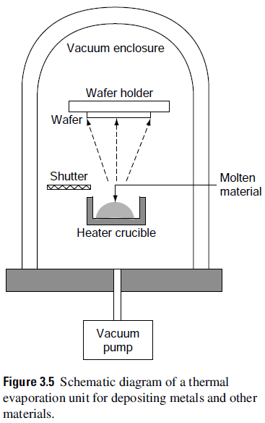
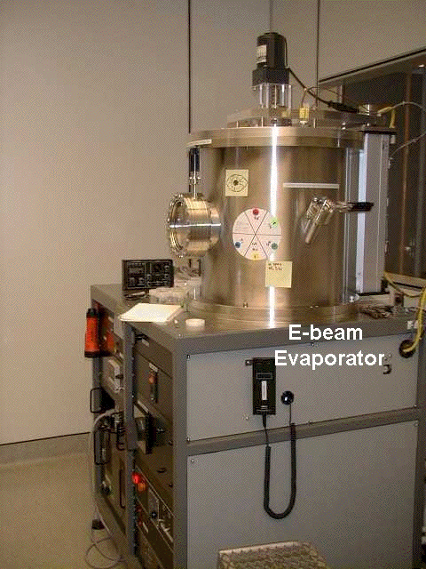
Thermal Evaporation Technique:
Evaporation is a relatively simple process of deposition of metal films on a substrate. It is based on the boiling off (or sublimating) of a heated material (mostly pure metals) onto a substrate.
Such materials are transformed from the solid source to the vapour state in a vacuum and subsequently deposited by condensing them over a substrate surface.
An evaporation system consists of an evaporation chamber, high-vacuum pumping system, substrate holder, crucible/filament, and a shutter.
The source material is placed in the crucible/filament.
The chamber is evacuated using vacuum pumps to a pressure of 10⁻⁶ to 10⁻⁷ torr.

Slide 16
The crucible/filament is heated by passing a heavy current onto the material. The evaporated metal condenses on the substrate.
During evaporation, metals are often evaporated by passing a high current through a highly refractory metal like W, Mo in the form of boats/spirals/crucibles.
The target material is placed inside these filaments and current is applied to heat the container, which then heats the material in contact with it.
During the process, the shutter covers the heating filament until the target material wets the filament surface (wetting), which triggers the sublimation process and onset of deposition.
During deposition, immediate removal of the shutter is required.
Due to sublimation at very low pressures, the metal atoms experiences very high mean free path and practically deposit directly over the substrate without any collision resulting in a very smooth film.
This method is called Resistive heating and the process is called Thermal evaporation.
Evaporation by resistive heating is used only for low melting point metals (e.g. Al, Ag, Cu)

Slide 17
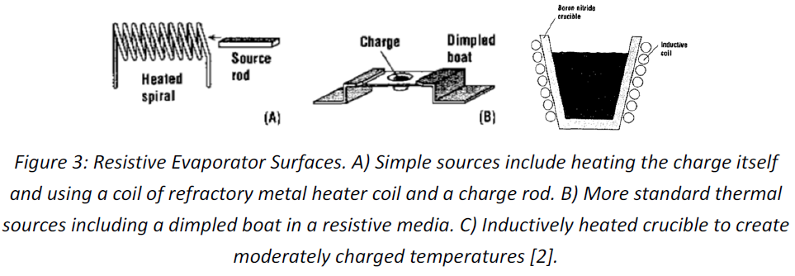
Different types of deposition evaporators
The thickness of the deposited film depends upon the duration of evaporation and the distance between the source and the crucible.
Purity depends upon contaminations from the source, support material (such as the substrate holder and the crucible), and residual gases. The purity of the source material is normally is of the order of 99.99%.
Metal alloy films can be deposited by evaporating constituent elements simultaneously from different sources.

Slide 18
Advantages of low deposition pressure:
Deposition at a low pressure of 10^{–6} Torr ensures very less, ~ 4.4 contaminating monolayers per second to impinge on the substrate. High vacuum levels are maintained by series of vacuum pumps. Rotary pumps are used to drive the initial vacuum levels of upto 10⁻³ Torr and thereafter diffusion pumps are used to further reduce the pressure to 10⁻⁶ Torr.
Because heating is accomplished in a vacuum, the temperature required for vaporization is significantly below the corresponding temperature required at atmospheric pressure.
At very low pressures, the mean free path (MFP) of the evaporation particle increases rapidly leading to straight atomistic deposition without any collisions between the particles and/or deposition walls.

Slide 19
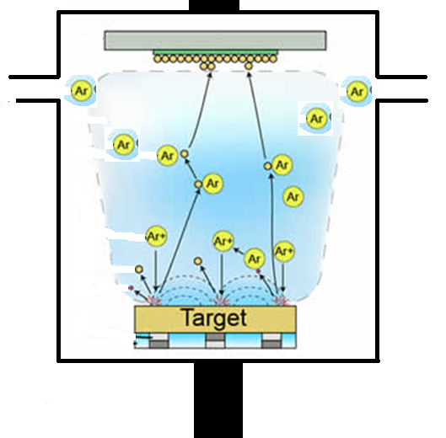
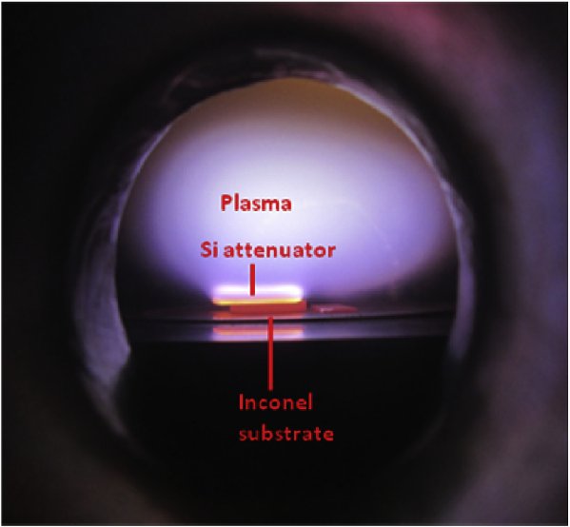
Sputtering Technique:
Substrate/
Anode
Ar in
Ar out/
To Pump
To DC/RF
Source
Argon atoms
Glow discharge
Argon ions
Target atoms
electrons
Target/ cathode
Cooling water

Slide 20
The vacuum in the chamber is evacuated to 10⁻⁶ to 10⁻⁸ torr.
Argon gas is introduced into the chamber and the pressure is maintained at a few millitorr (10⁻³ torr).
Argon is ionized by the application of a dc (for conducting targets) or RF (for insulators) voltage.
The ions are then accelerated through a potential gradient to bombard a target which is set to be the cathode.
Because of the momentum transfer of the accelerated ions to the atoms near the surface, target atoms eg NiCr, are released and are transported in vapour form to the substrate for deposition.
The deposition rate depends on the sputtered material, RF power applied, pressure inside the chamber, and spacing between the electrodes.
Compound thin films can be deposited by using co-sputtering from multiple targets.
With sputtering, it is possible to obtain the same stoichiometric composition, alloys can also be sputtered.
Sputtered films usually have good compositional uniformity, adhesion to substrate surface, and grain orientation.

Slide 21
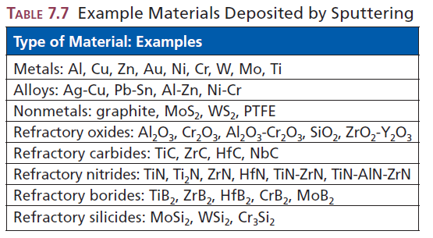
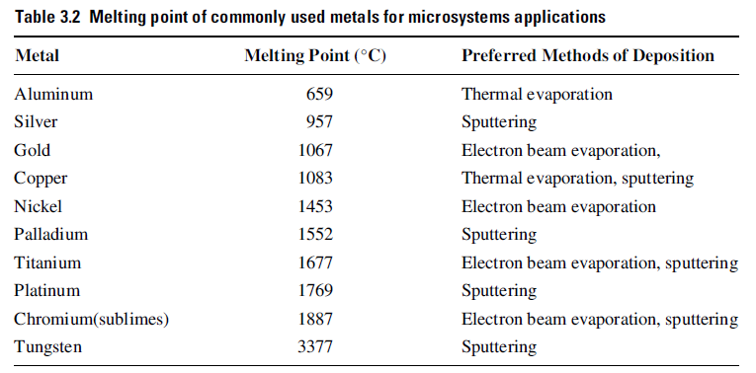

Slide 22
Conformal and non-conformal coating:
Sputtering
Thermal Evaporation
Pressure ~ 10⁻³ mbar
Associated with mild collisions/reflections
Side wall deposition (Conformal)
Pressure ~ 10⁻⁶ mbar
No collisions/reflections;
straight deposition (large MFP)
No Side wall deposition (Non-conformal)

Slide 23
Chemical Vapour Deposition (CVD):
Chemical vapour deposition (CVD) is one of the principal thin film manufacturing options.
During CVD, the constituents of a vapour phase, often diluted with an inert carrier gas, react at a hot surface (typically higher than 300°C) to deposit a solid thin film.
Most CVD processes involve low gas pressures (100–200 mtorr ~ 100-200 x10⁻⁵ mbar)
In CVD, the mass and heat transfer modelling of deposition rates is consequently much more complex than in PVD.
Parameters that significantly influence the rate of CVD are:
1. Temperature
2. Pressure of carrier gas
3. Velocity of gas flow
4. Distance along the direction of gas flow

Slide 24
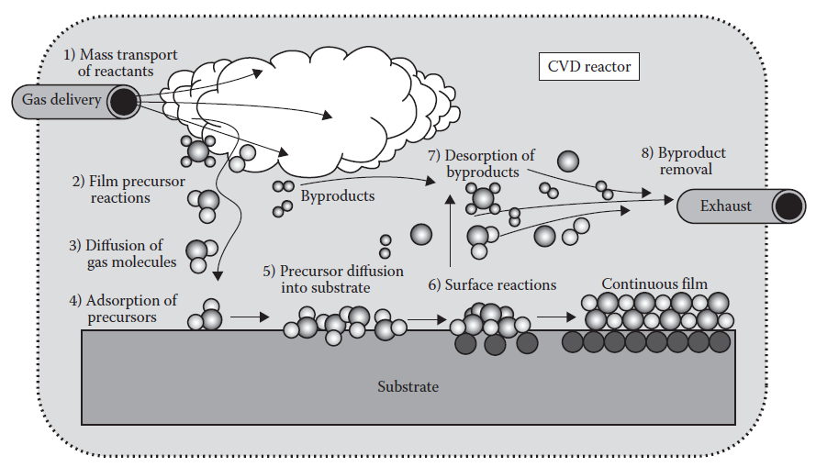
Schematic of transport and reaction processes underlying CVD.

Slide 25
Reaction Mechanisms and CVD Reactor:
◾ Mass transport of reactant and diluent gases (if present) in the bulk gas flow region from the reactor inlet to the deposition zone (1).
◾Gas-phase reactions (homogeneous) leading to film precursors and by-products (often unselective and undesirable) (2).
◾Mass transport of film precursors and reactants to the growth surface (3)
◾Adsorption of film precursors and reactants on the growth surface (4) - sticking coefficient, surface adsorption,
◾Surface migration of film formers to the growth sites (5) - surface diffusion,
◾Surface reactions (heterogeneous) of adatoms occurring selectively on the heated surface, and incorporation of film constituents into the growing film, that is, nucleation (island formation) (6)
◾Desorption of by-products of the surface reactions (7)
◾Mass transport of by-products in the bulk gas flow region away from the deposition zone toward the reactor exit (8)
The slowest of any of the CVD steps mentioned i.e. the gas phase or surface process, determines the rate of deposition. The most favourable end product of the physical and chemical interactions on the substrate surface is a stoichiometric-correct film.

Slide 26
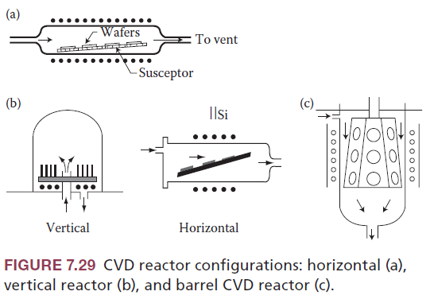
CVD reactor configurations:
CVD techniques covered are:
1. PECVD (plasma-enhanced CVD),
2. HDPCVD (high-density plasma CVD ),
3. APCVD (atmospheric pressure CVD ),
4. LPCVD (low-pressure CVD),
5. VLPCVD (very low-pressure CVD ),
6. ECRCVD (electron cyclotron resonance CVD ),
7. MOCVD (metalorganic CVD ), and
8. ALD (atomic layer deposition ).
CVD reactor configurations: (a)horizontal, (b)vertical reactor, and (c)barrel CVD reactor.

Slide 27
Differences between Physical vapour deposition (PVD) and Chemical vapour deposition (CVD):
PVD constitutes a group of direct line-of-sight impingement deposition techniques (evaporation or collisional impact) , whereas CVD represents a class of diffusive /convective mass transfer deposition techniques associated with a chemical reaction.
PVD is mostly limited to metal film deposition (solid or molten sources), whereas CVD includes a wide range of pressures and temperatures and can be applied to a great variety of coating and substrate materials (in gaseous form).
In PVD techniques, sputtering leads to a better conformal coating than evaporation, but CVD has a better film quality than sputtering.
PVD operates at room temperature, whereas CVD operates at elevated temperature, resulting in better crystalline films than PVD.

Slide 28
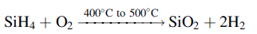
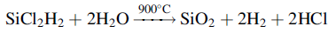
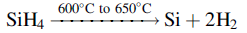
Silicon Dioxide:
The commonly used carrier gas is O₂ and the other reactant is silane (SiH₄). The chemical reaction involved is:
This may also be done by decomposing dichlorosilane:
Polysilicon
Deposition of polysilicon is typically done by a decomposition of silane using an LPCVD process. The following chemical reaction takes place:
These have small grains separated by grain boundaries which are used in microelectronics for electrodes and as a conductor or high-value resistor.

Slide 29
Advantages of CVD technique:
It is possible to deposit refractory materials at temperatures below their melting or sintering temperatures.
Control of grain size is possible.
The process can be carried out at atmospheric pressure (it does not require vacuum equipment) and
Good bonding of coating to substrate surface.
Disadvantages of CVD technique:
Corrosive, flammable, explosive and/or toxic nature of chemicals generally necessitates a closed chamber and special pumping and disposal equipment.
Certain reaction ingredients are relatively expensive and
Material utilization is low.

Slide 30
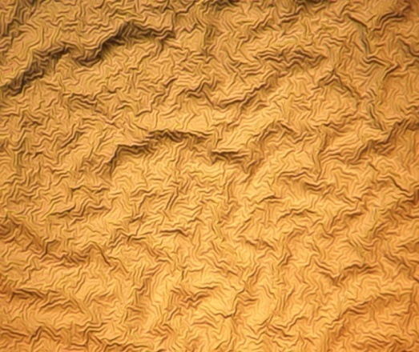
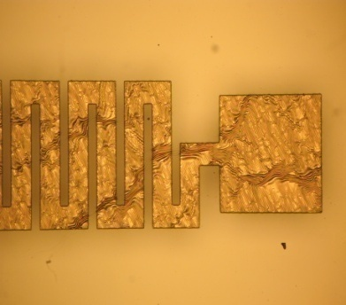
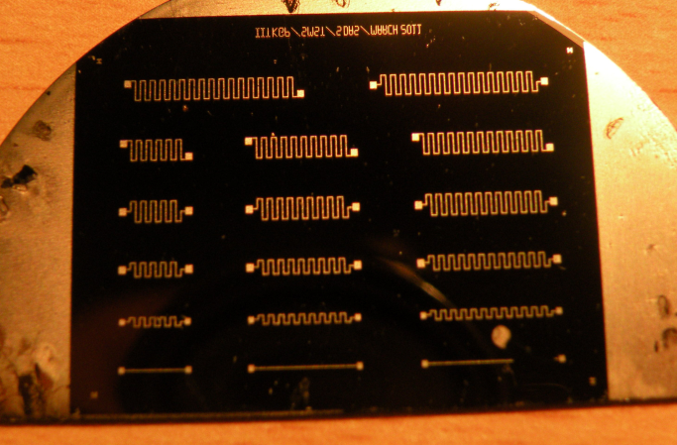
LITHOGRAPHY
Lithography comes from two Greek words, “Lithos” means stone and “Graphein” means write. Lithography means literally “writing a pattern in stone”
In microelectronics – Lithography is used to describe a process in which a pattern/image from a mask is delineated in a layer of material sensitive to photons, electrons or ions.
Photolithography is the heart of integrated circuit/ MEMS sensor processing - Transfer the individual circuit design data onto the silicon wafer.

Slide 31
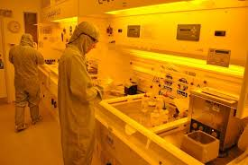
CLEANROOM
A cleanroom or clean room is an environment, typically used in manufacturing, including of pharmaceutical products or scientific research, as well as aerospace semiconductor engineering applications with a low level of environmental pollutants such as dust, airborne microbes, aerosol particles, and chemical vapors.
Cleanrooms are classified according to the number and size of particles permitted per volume of air. Large numbers like "class 100" or "class 1000" , and denote the number of particles of size 0.5 µm or larger permitted per cubic foot of air.
Small numbers like class5 has at most 10⁵ particles/m³, which specify the decimal logarithm of the number of particles 0.1 µm or larger permitted per m³ of air.

Slide 32
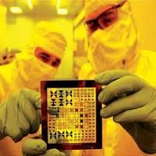
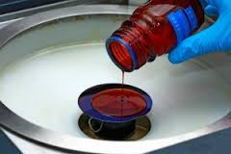
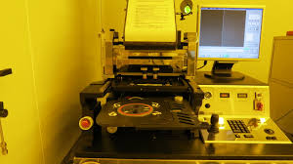
Requirements for lithography:
Masks containing design information
Photo-sensitive Resist
An Alignment and Exposure Tool

Slide 33
Layout, Mask & Photo
Layout
Convert electrical design to physical design
2D ‘picture’ of the final chip (quantitative)
Mask
Creates a physical layout (similar to photo negative)
Can be used to general many chips (similar to obtaining many copies from a negative)
Photo (Lithography)
Process of obtaining a ‘picture’ from a ‘negative’
(ie generating shapes on wafer from a mask)

Slide 34
Photolithography process
This flow chart shows the typical process used for VLSI Lithography. Most of these steps are inter-related to a great extent. Through the next few slides we will discuss all these steps in detail.
Substrate Cleaning
Spin coat
Pre-bake
Post bake
Development
Expose
Etch
Strip

Slide 35
Photolithography process
Thin film deposition- Metal/SiO₂
5. Photoresist development
6. Inspection
Silicon Wafer
Surface cleaning,
Photoresist spin coating
Silicon Wafer
7. Post -baking
Silicon Wafer
8. Etching of deposited layer
3. Pre-baking
Mask
4. UV Exposure
Silicon Wafer
9. Photoresist striping
Silicon Wafer
Silicon Wafer
UV light
10. Final Inspection
Silicon Wafer

Slide 36
Patterned Sensors

Slide 37
Photolithography process
1. Substrate Cleaning and Preparation
The surface is as clean as possible immediately after a high temp operation. Acid cleaning may be necessary if wafers sit for a long time.
Acid Cleaning is done using Piranha solution [H₂O₂ : H₂SO₄ (1:1)] for 30 min followed by rinsing in DI (deionized) water for 5 min and drying with Pure Nitrogen gas.
A dehydration bake can be performed at 200 - 400°C.
The surface of the wafer is often “primed” with HMDS to promote adhesion. (hexamethyldisilazane)
Thin film deposition- Metal/SiO₂
Silicon Wafer
2. Photoresist coating
The goal of coating is to apply a uniform, defect free film of photoresist over the entire wafer surface by spin coating. Getting exact thickness is important.
dispense resist - flood wafer
accelerate the wafer - fast
spin at constant speed to get uniform thickness
Photoresist
Silicon Wafer

Slide 38
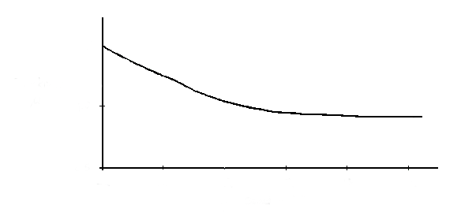
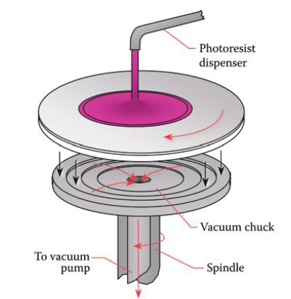
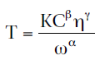
Photolithography process
The empirical expression for T is given by:
1.5
Thickness
μm
1.0
Where,
K = the overall calibration constant
C = the polymer concentration in g/100-mL solution
η = the intrinsic viscosity
ω = the number of rotations per minute
0.5
2k
3k
4k
5k
6k
7k
Spin Speed (RPM)
Typical coat process is 4000 RPM for 30 sec.
Thickness Spec = 1μ ± 100 Å
Resist viscosity must be controlled to control the thickness. Ambient temperature should be controlled within 20 ± 1°C.
The humidity must be set at about 45 ± 1 % RH.
Typical examples of Photoresists are: AZ series – Thick +PR (can go upto ~ 50 µm thickness)
HPR 504 – Thin +PR (~ 1 µm thickness)
SU8 5,10, 50, 100: -ve PR

Slide 39
3. Pre-Bake ( Soft-Bake )
Drive off solvent from resist. (Reduce from ~25% to ~5%)
Improve adhesion
Anneal stresses in resist – hinder crack formation
Typical process Temp is 90°C for 30 min
Convection oven, IR oven, Hot plate.
4. Expose
The goal of the exposure process is to produce the desired photochemical effects in the shortest time.
Short times usually mean lower resolution. Exposure is affected by other process steps:
Spin-Resist Thickness
Soft-Bake Resist chemistry
Develop – line width control
Etch – line width control
UV light
Mask
Silicon Wafer

Slide 40
Develop
Development removes the unwanted photoresist.
Positive Resist - Area exposed to light is removed
Negative Resist - Area not exposed to light is removed -
Uses Organic Solvent Developer.
Development Process Includes
Development by Immersion or Spray
Rinse in DI water
Dry – using Nitrogen gun
6. Development Inspection
Development Goals
Keep original resist thickness
Short development time
Minimum pattern distortion
Pattern dimensions should be precisely produced

Slide 41
7. Post-Bake at 120°C 30 minutes
Hardens Resist prior to etch
Temperature is critically maintained
Etching of deposited layer
8. Etch
Dry Plasma Etch is used in commercial manufacturing lines.
Wet chemical etch with acids – low cost and flexibility of the process.
9. Strip (Photoresist removal)
The Strip process is a complete removal of the Photoresist.
Dry Plasma Strip in O₂ is commonly used
Wet Chemical Strip in special solvents (Acetone)
– low cost and flexibility of the process.
Removal of top PR layer
10. Final Inspection: To ascertain proper feature size of the final metal structures obtained

Slide 42
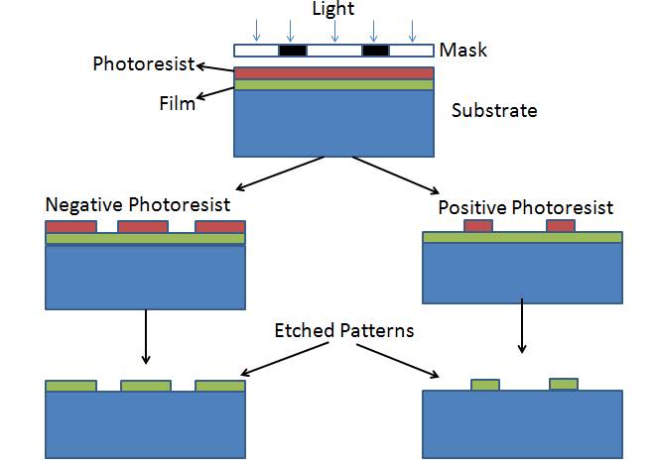
Photoresists are of two types
Positive resist
Negative resist

Slide 43
Photoresists – is a organic chemical consisting of resin, photoactive compound and solvent (to maintain proper viscocity) Characteristics: Good adhesion, resistance to dry and wet etch process,
Negative photoresist – on exposure to light, photoactive agent reacts with rubber to form crosslinks between rubber molecules, making the rubber less soluble in an organic developer.
Resin: polyisoprene rubber
Photoactive component: Bis-aryl-diazides
Solvent: Aliphatic & aryl hydrocarbon
Development: Pattern is formed by masking away the unpolymerised resist with solvent (Hydrocarbon mixture).
Problem: Developer is absorbed by the exposed resist results in swelling of resist at the pattern edges and thus, distorting the pattern features.

Slide 44
Positive photoresist – does not rely on polymerisation. The photoactive component is dissolution inhibitor. When it destroyed by exposure to light, the resin becomes more soluble in aqueous developer solution.
Resin: Phenol formaldehyde novolac
Photoactive component: Diazo-oxides
Solvent: Ethylene glycol monoethyl ether
Development: Pattern is formed by washing away the exposed resist in aqueous developer solution.
The unexposed regions do not swell in the developer solution. Thus higher resolution is possible.
However, development is critical since unexposed resist washed out slowly.
Development speed is a smoother function of absorbed light and also depends on developer concentration.
Development begins at the surface and proceeds downward in both exposed and unexposed regions. It attacks sidewalls and thus, line width will vary.

Slide 45
Etching
Etching is used to remove unwanted material from a layer of interest.
Etching is a chemical reaction in which no solid precipitate is formed.
It can be done either in the liquid or the gaseous phase (wet etching or dry etching).
In the liquid-phase reaction, known as wet etching, the material is removed by chemical reaction between the etching solution and the material on the substrate surface.
In dry etching, this is done by chemical/physical interaction between atoms of an ionized gas and the substrate.
In most wet etching processes, the etch rate is uniform in all directions, that is, it is isotropic and does not depend on crystal structure/orientation.
The basic steps involved in the wet etching process are:
1. Injection of holes into the silicon substrate to create the Si⁺ state.
2. Attachment of a negatively charged OH group to positively charged Si.
3. Reaction between hydrated Si and complex agents in etchant solution.
4. Dissolving of reaction products into etchant solution.

Slide 46
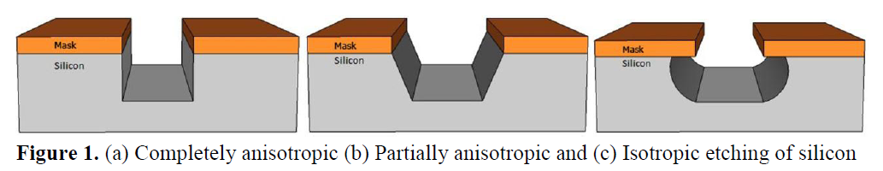
Wet etching of Si:
Isotropic Etching:
Removes material equally in all crystallographic direction, results in undercutting and uncontrolled etch features
Isotropic Etchant for Si: Mixture of HNO₃ & HF in H₂O or CH₃COOH
Anisotropic Etching:
Crystallographic dependent etching, where etch rates vary according to the type of plane exposed to the etchant.ie, a given crystal plane of a semiconductor etches faster than other planes
Anisotropic Etchant for Si: Ethyline Diamine Pyrocatechol (EDP), Potassium Hydroxide (KOH), Hydrazine, TMAH (tetramethyl ammonium hydroxide, (CH₃)₄ NOH), NH₄OH
Isotropic Etching (Wet etching)
Partial Anisotropic Etching (Wet etching)
Complete Anisotropic Etching (Dry etching)

Slide 47
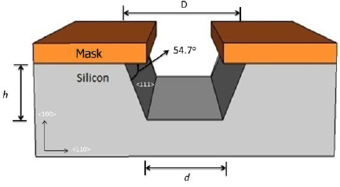
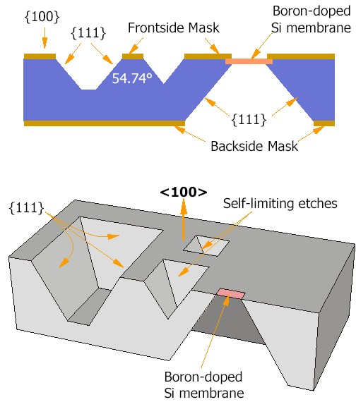
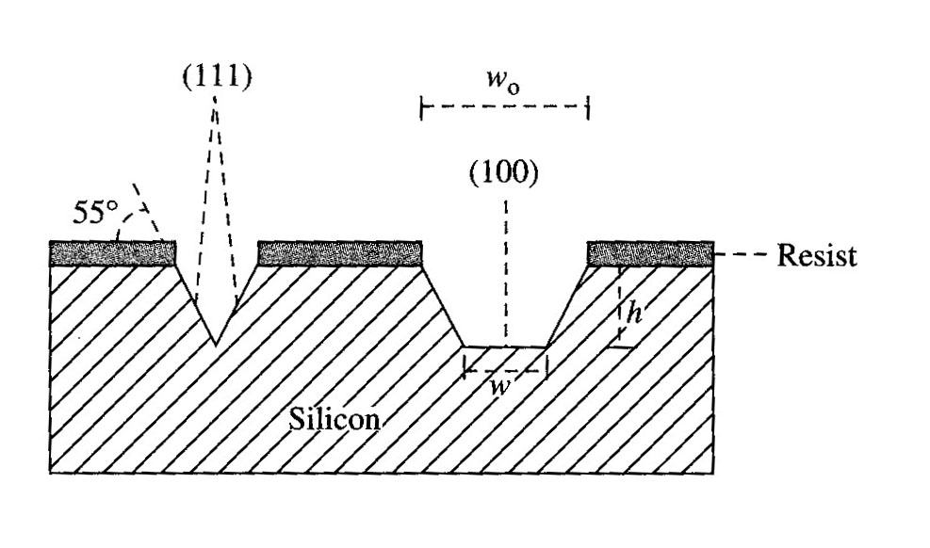
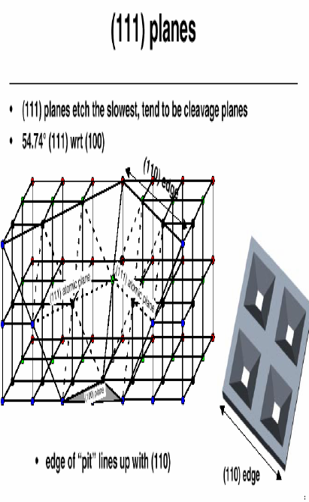
Anisotropic Wet Etching of Silicon
µ- tub
µ- needle
Si-membrane
w = w₀– 2h cot (54.74⁰)
= w₀ – 1.4 h
µ- nozzle

Slide 48
Anisotropic Wet Etchants of Silicon
Hydrazine (N₂H₄.H₂O ) : extremely toxic and its vapor is explosive
EDP : also is toxic, but to a lesser extent than hydrazine
KOH : has the disadvantage of being incompatible with IC process
TMAH [(CH₃)₄NOH] : nontoxic and IC compatible but fewer studies exist on this system, results in very flat faces
A number of issues have to be considered in the final choice of the etchant
Ease of handling
Toxicity
Etch rate, Etch stop, Etch selectivity
IC compatibility
Topology of the etch ground
Mask material and thickness of the mask

Slide 49
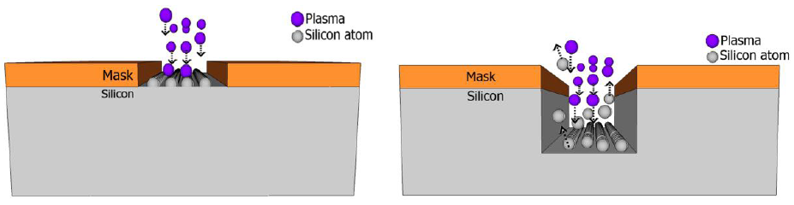
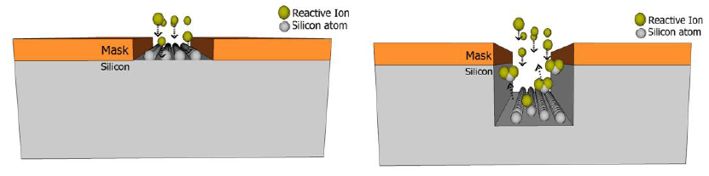
Dry Etching
Physical dry etching:
Physical dry etching requires high energy kinetic energy (ion, electron, or photon) beams to etch off the substrate atoms. When the high energy particles knock out the atoms from the substrate surface, the material evaporates after leaving the substrate. There is no chemical reaction taking place and therefore only the material that is unmasked will be removed.
Chemical dry etching:
Chemical dry etching (also called vapor phase etching) involves a chemical reaction between etchant gases to attack the silicon surface. A bond between the reactive ion and the silicon atom then chemically remove the silicon atoms from the surface. It is usually isotropic and exhibits high selectively and may be anisotropic with higher aspect ratio than isotropic etching.
Eg.-tetrafluoromethane (CH4), sulfur hexafluoride (SF6), nitrogen trifluoride (NF3), chlorine gas (Cl2), or fluorine (F2).

Slide 50
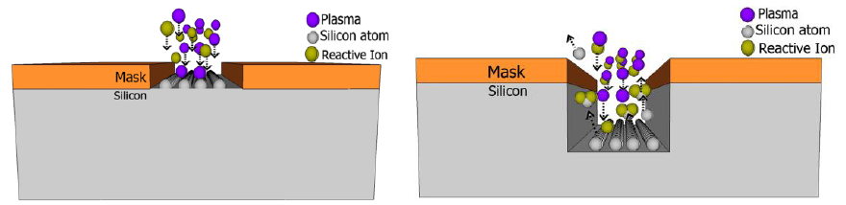
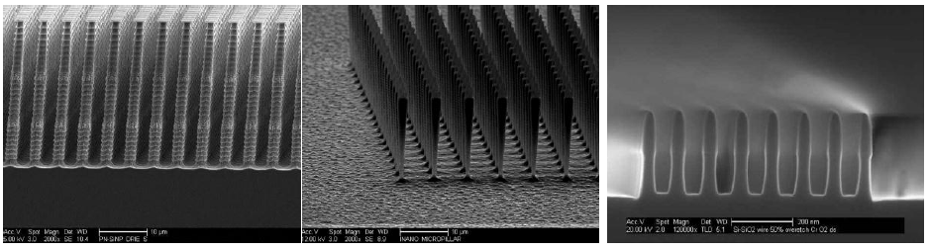
Reactive Ion Etching:
Reactive ion etching (RIE)/ DRIE (Deep RIE) uses both physical and chemical mechanisms to achieve high levels of resolution.
The process is one of the most diverse and most widely used processes in industry and research.
Since the process combines both physical and chemical interactions, the process is much faster. The high energy collision from the ionization helps to dissociate the etchant molecules into more reactive species. In the RIE-process, cations are produced from reactive gases which are accelerated with high energy to the substrate and chemically react with the silicon.
The typical RIE gasses for Si are CF₄, SF₆ and BCl₂ + Cl₂.

Slide 51
Silicon Micromachining
Bulk Micromachining
Surface Micromachining
Bulk Micromachining:
Using single crystalline silicon wafer, the bulk material of the substrate along thickness direction is dissolved / etched by wet chemical etchant to realize various 3-D micromechanical structures
Device thickness is controlled by etching/ diffusion
Mechanical properties of bulk silicon is preserved
Alignment required for top and bottom side of wafer
Require etch stop mechanism

Slide 52
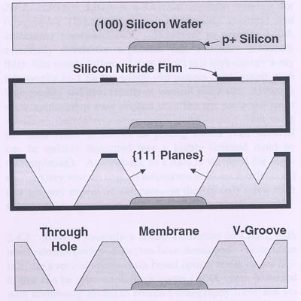
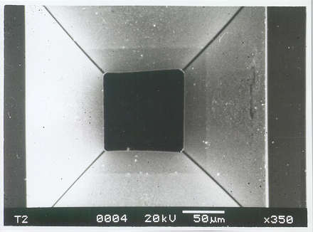
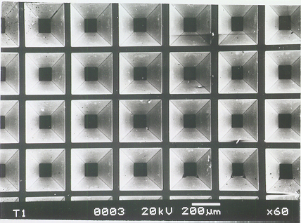
Bulk Micromachining
Bulk micromachining along crystallographic planes

Slide 53
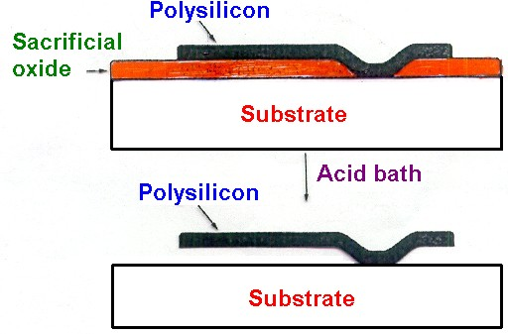
Surface Micromachining
This technology is based on depositing and etching structural and sacrificial films. After deposition of thin film, sacrificial layer is etched away, leaving a completely assembled microstructure
Maximum possible thickness of the microstructure is limited to that of the deposited film

Slide 54
Surface Micromachining: Sacrificial Layer Technology
Key processing Steps
Deposition and patterning of a sacrificial SiO₂ layer on the substrate
Deposition and definition of a poly-Si film
Removal of the sacrificial oxide by lateral etching in hydrofluoric acid (HF), i.e etching away of the oxide underneath the poly-Si structure
Here, Poly-Si and SiO₂ are referred as the structural and sacrificial materials, respectively.

Slide 55
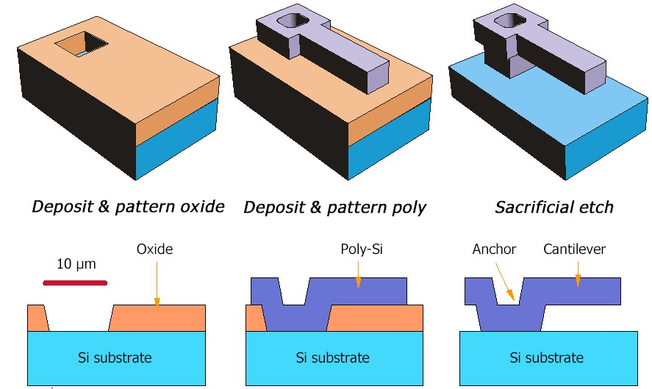
Cantilever Structure by Surface Micromachining

Slide 56
Surface Micromachining
Surface-micromachined structures can be an order of magnitude smaller than the bulk – micromachined structures.
The main advantage of surface-micromachined structures is their easy integration with integrated circuit (IC) components, as the same wafer surface can also be processed for IC elements.
Striction due to Van der Waals forces and hydrogen bonding.
Thermal expansion matching between different layers is an important issue leading to induced stress.
Limitations:
Maximum device thickness is limited to the deposited film.
Stiction due to van der Waals force and hydrogen bonding
Thermal expansion matching / induced stress / measurement of stress

Slide 57


Slide 58
Comparison
Bulk Micromachining Surface Micromachining
Advantages | Disadvantages | Advantages | Disadvantages
Well established (since 1960) and well-characterized material(ie Si) | Uses mostly Si and thus device properties are limited | Use several materials, allows for new application | Some of the materials are not well understood and explored completely.
Rugged structure that can with-stand vibration and shock | Large die areas that give it high cost | Small die area that makes it cheaper | Less rugged structure with respect to vibration & Shock
Large mass/area (suitable for accelerometers & capacitive sensor | Not fully integrated with IC processes | Easy integration with integrated circuit (IC) components. | Small mass/area, which would typically reduce sensitivity
No stiction issues while etching. Structures are easily realized by etching. | Limited structural geometry possible | Wider range of structural geometry | Stiction due to Van der Waals forces and hydrogen bonding during etching process.

